Slide 1

INVESTIGATING MUSIC SENTIMENT
Nikhil Nagaraj & Rui Silva
Computational Creativity – Capita Selecta Computer Science

Slide 2
Music – A quick primer
Beat : A basic unit of time in music.
Tempo : The pace of a given piece. Usually represented as beats per minute.
Bar : A small section of music. Every bar (usually) has the same number of beats in it.
Note : Denotes a musical sound. A whole note corresponds to 4 beats.
16th Note : Corresponds to 1/16th a whole note.
MIDI : A technical standard for electronics and interfaces related to music.

Slide 3
Sentiment in Music
Tempo
Loudness
Melody
Perception of negativity or sadness inversely proportional to tempo
Perception of sadness increases for softer music.
Complementing melodies create a sense of happiness and content
Rhythm
A smooth, regular rhythm generates a sense of relaxation
Listener
Perception of sentiment is not universal.

Slide 4




Existing Research*
Music + AI
Magenta
(Google)
OpenAI
Others
MusicVAE
Music Transformer
MuseNet
Learning to Generate Music with Sentiment

Slide 5
LEARNING TO GENERATE MUSIC WITH SENTIMENT
Lucas N. Ferreira; University of California, Santa Cruz; Department of Computational Media
Jim Whitehead; University of California, Santa Cruz; Department of Computational Media
(2019)

Slide 6
Sentiment Labelling
Valence
Valence: Refers to the intrinsic goodness or the averseness/badness of an object ^{[1]}
Arousal: Refers to the intensity of the intrinsic emotion
Arousal

Slide 7
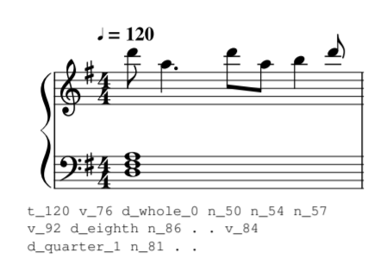
Data representation
Represent a music piece as a sequence of words and punctuation marks from a vocabulary that represents events retrieved from the MIDI file
“n_[pitch]”, “d_[duration]_[dots]”, “v_[velocity]”, “t_[tempo]”, “.”: end of time step, “\n”: end of piece
Embedding size: 64

Slide 8


Network Overview (Classification)
Music Data
Unlabeled Music
Labeled Music
Train
Labels
Generative mLSTM
Logistic Regression
Final Cell State

Slide 9

Network Overview (Generation)
Genetic Algorithm
Modify weights
Select high impact parameters
Generative mLSTM
Logistic Regression

Slide 10
Classification Results
Vastly outperforms supervised mLSTM.
Music generation produces mixed results.

Slide 11
A Hierarchical Latent Vector Model for Learning Long-Term Structure in Music (MusicVAE)
Adam Roberts 1 Jesse Engel 1 Colin Raffel 1 Curtis Hawthorne 1 Douglas Eck
(2018)

Slide 12
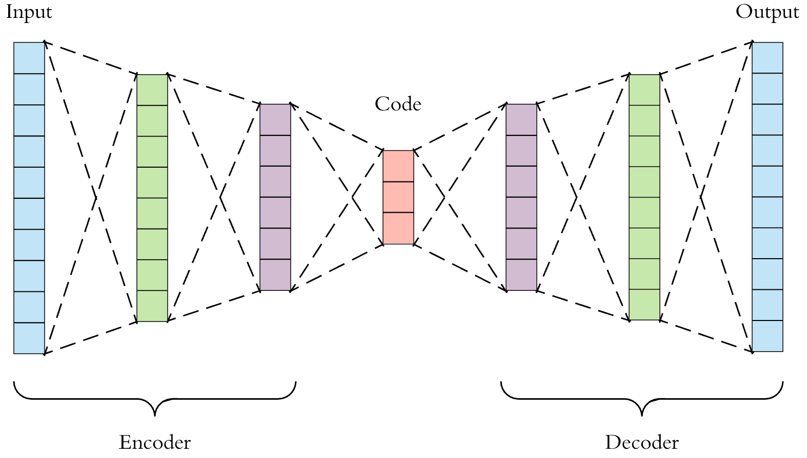
Autoencoder
An autoencoder is used to achieve lossy compression of an input data point.
Intermittent code contains latent features which can be used by the decoder to reconstruct the input.
The standard autoencoder is trained to minimize reconstruction loss.
Notes:
https://towardsdatascience.com/applied-deep-learning-part-3-autoencoders-1c083af4d798

Slide 13
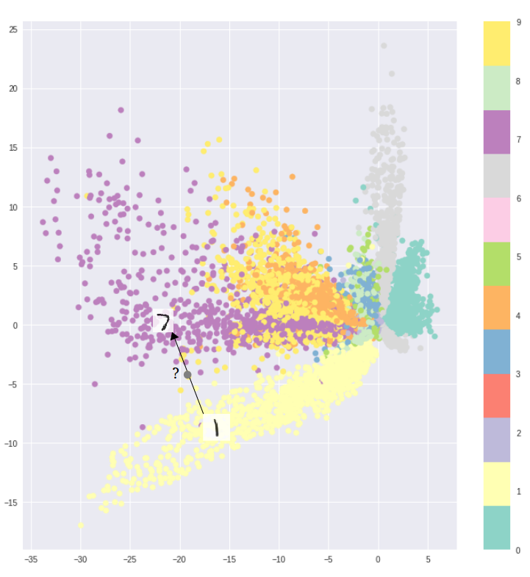
Autoencoders & Generative Processes
Generative models should be able to generate variations on the inputs and not just reconstruct them.
Fundamentally unsuitable due to the lack of continuity in the latent code.
A randomly sampled latent code might not mean much to the decoder and will probably result in unrecognizable output.
Interpolation between latent codes is futile due to this lack of continuity.
Notes:
https://towardsdatascience.com/intuitively-understanding-variational-autoencoders-1bfe67eb5daf

Slide 14
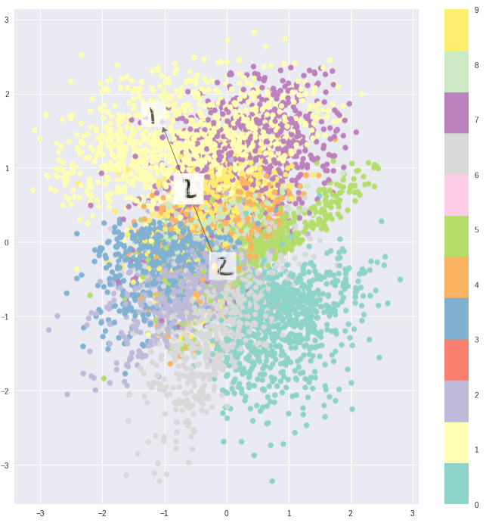
Variational Autoencoder
Designed to have continuous latent space, allowing easy sampling and interpolation.
This is performed by adding a regularization term to the loss function which encourages compactness in the latent space distribution.

Slide 15
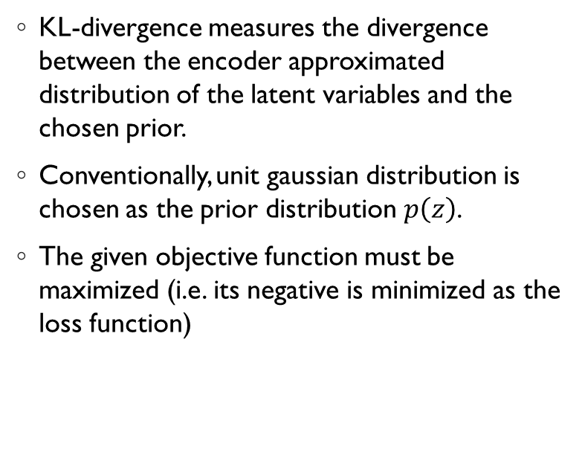
Variational Autoencoder – Objective Function
KL-divergence measures the divergence between the encoder approximated distribution of the latent variables and the chosen prior.
Conventionally, unit gaussian distribution is chosen as the prior distribution $p\left(z\right)$.
The given objective function must be maximized (i.e. its negative is minimized as the loss function)

Slide 16
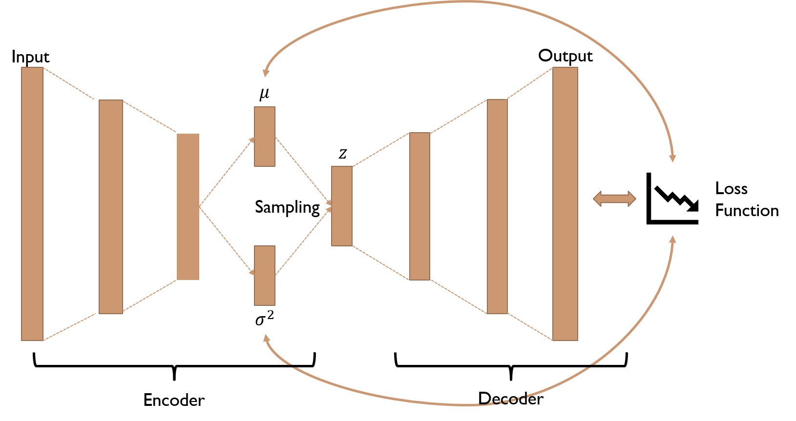
Variational Autoencoder - Network
Instead of a single latent vector, the encoder produces mean and variance components.
KL divergence in the loss function incentivizes the mean and variance to be as close as possible to those in a unit gaussian function.

Slide 17
Data Encoding
The monophonic melodies are encoded as sequences of 16th note events.
This resulted in a 130- dimensional output space (categorical distribution over tokens) with 128 “note-on” tokens for the 128 MIDI pitches, plus single tokens for “note-off” and “rest”
For timing, notes were quantized to 16th note intervals, such that each bar consisted of 16 events. As a result, two-bar data resulted in sequences with T = 32 and 16-bar data had T = 256.

Slide 18
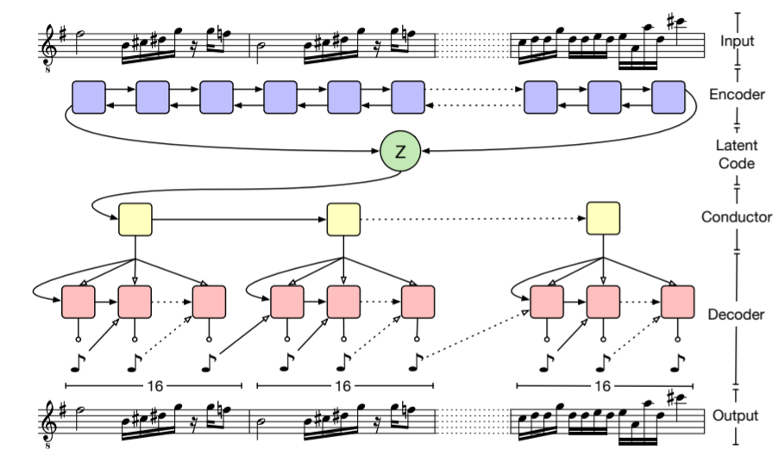
MusicVAE
A VAE based architecture to generate music samples.
The use of a hierarchical decoder is a novel feature of this architecture.
Hierarchical decoder is used to combat the autoregressive characteristic of an RNN.
It increases the dependence of the final output on the latent vector, forcing the latent vector to encode meaningful music characteristics.
Initialization
Input

Slide 19
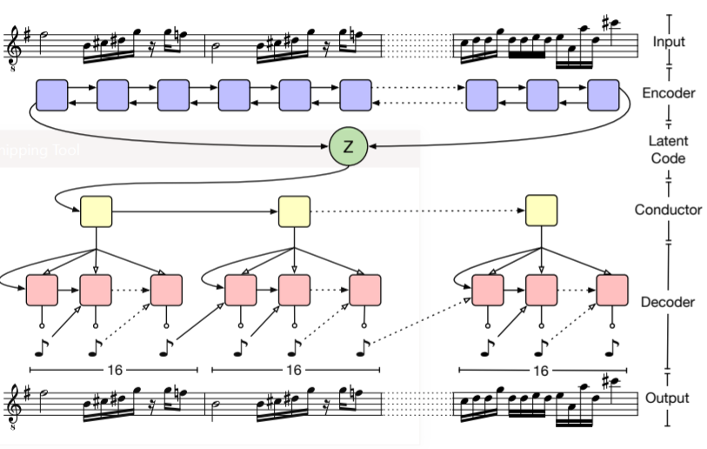
MusicVAE
VAE was trained over different configurations of data varying in:
Length (2bar/16 bar),
Track type (melody/drum)
Number of instruments (1/3)

Slide 20
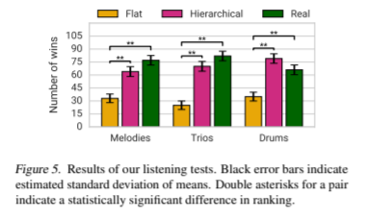
MusicVAE - Observations
Listening tests of samples taken in pairs indicate that the hierarchical decoder performs much better than the flat decoder.
The results from the hierarchical decoder are comparable to real samples.
These results indicate that the latent space is encoding music characteristics appreciated by listeners.

Slide 21
Our Focus
Explore
Explore classification of music sentiment by partitioning the latent space
Map
Map the effects of latent space dimension on sentiment classification
Compare
Compare results with the current SOA in music sentiment classification
Test
Test this method of sentiment classification on some popular incidental music
Generate
Generate positive/negative pieces by sampling from the appropriate partition

Slide 22
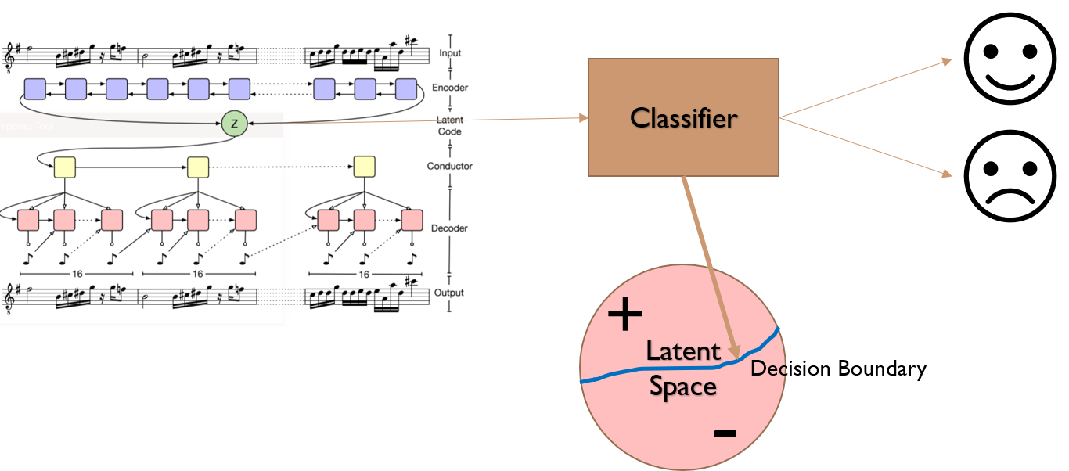
Sentiment Classification – Latent Space Partition
A classifier is trained to partition the latent space.
Experiments use 16-bar, melody only samples.

Slide 23
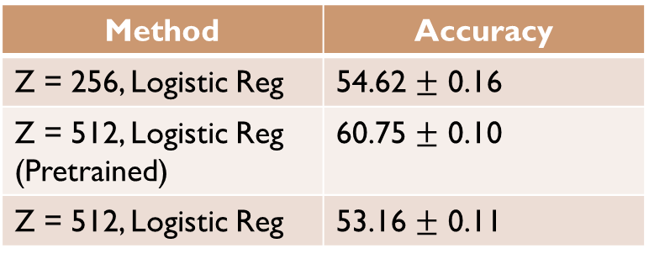
Sentiment Classification – Latent Vector Size
Method | Accuracy
Z = 256, Logistic Reg | 54.62 $±$ 0.16
Z = 512, Logistic Reg (Pretrained) | 60.75 $±$ 0.10
Z = 512, Logistic Reg | 53.16 $±$ 0.11
VAE was trained with Z-sizes of 256 and 512.
Samples of length 16bar were used.
Sentiment classification accuracy using Logistic Regression was higher for the pretrained model.
This might have to do with a longer training time and larger amount of data.

Slide 24
Sentiment Classification - Comparison with SOA
No universally agreed upon SOA, but available literature indicates Generative mLSTM + Logistic Regression provides the highest accuracy for sentiment classification.
A parallel training objective emphasizing the quality and accuracy of the sentiment while training the VAE might lead to an increase in sentiment classification accuracy.
Information about the track is lost as the VAE only encodes melody-based information.
Method | Accuracy
Gen. mLSTM + Log. Reg | 89.83% ~ 3.14
MusicVAE (Pretrained) + Log. Reg | 63%
MusicVAE (Pretrained) + SVM | 65%

Slide 25
Sentiment Classification – Popular Music
Song Title | Ground Truth | Predicted
Jingle Bells | Positive | Positive
Happy Birthday | Positive | Negative
Dumbledore’s Farewell | Negative | Negative
Sadness and Sorrow (From Naruto) | Negative | Positive
Popular incidental music was used to test the classification method.
Mixed Performance.
20 tracks were classified with an accuracy of ~55%
The lack of complete musical information handicaps the classifier. For certain tracks, the backing tracks contain more sentimental information than the melody itself.

Slide 26

Sentiment based Music Generation
Latent vectors were sampled from the appropriate partitions to generate positive and negative tracks.
Results of music generation were mixed. The lack of a training objective enforcing retention of sentiment-based information in the latent vector is evident.
Positive and negative tracks seem to vary heavily in pitch (high/low) and tempo (fast/slow). A key based variance is found sometimes.
Positive Sample:
Negative Sample:
Subjectivity of the listener precludes accurate assessment of these tracks. Training with a discriminator style network (trained on music with undisputable sentimental characteristics) might aid in more accurate generation.

Slide 27
Future Improvements and Possibilities
Immediate Improvements
Training the network with a sentiment classifier should force the latent space to encode meaningful sentiment-based features.
Training the network with a discriminator style to critic the quality of music and the sentiment encoded by it might improve generation quality.
Scoring music with valence/arousal (instead of coarse positive/negative) might allow a gradation in the characteristics of the music generated.
Into the Unknown
Generating realistic music based on sentiment might allow automatic creation of incidental music for audiobooks and narration-based documentaries.
Generating realistic, coherent music based on events in a movie/video can allow for ‘AI’ film score composers.

Slide 28
END

Slide 29
References
Roberts, A., Engel, J. Raffel, C., Hawthorne, C. & Eck, D.. (2018). A Hierarchical Latent Vector Model for Learning Long-Term Structure in Music. Proceedings of the 35th International Conference on Machine Learning, in PMLR 80:4364-4373
Lucas N. Ferreira, and Jim Whitehead. Learning to Generate Music with Sentiment. In Proceedings of the 20th conference of the International Society for Music Information Retrieval (ISMIR), ISMIR'19, 2019.
Shafkat, I. (2018, April 5). Intuitively Understanding Variational Autoencoders. Retrieved from https://towardsdatascience.com/intuitively-understanding-variational-autoencoders-1bfe67eb5daf

